Slide 1
EDUCATION
&
TRAINING
PILLAR
BY
R.P.Kulkarni

Slide 2
1. DEFINITION OF EDUCATION

Slide 3
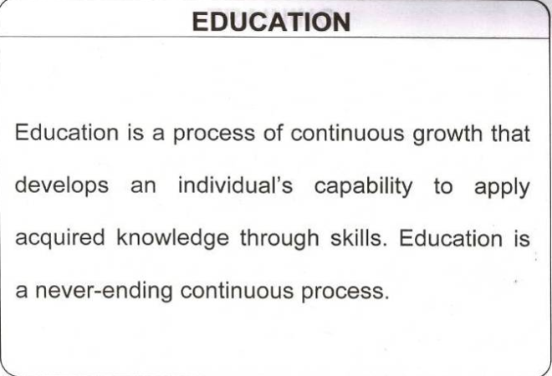

Slide 4
2. DEFINITION OF TRAINING

Slide 5
Training
Training is process of learning a sequence of programmed.
It gives people an awareness of the rules and procedure to guide their behavior.

Slide 6
3 Understanding about Training

Slide 7
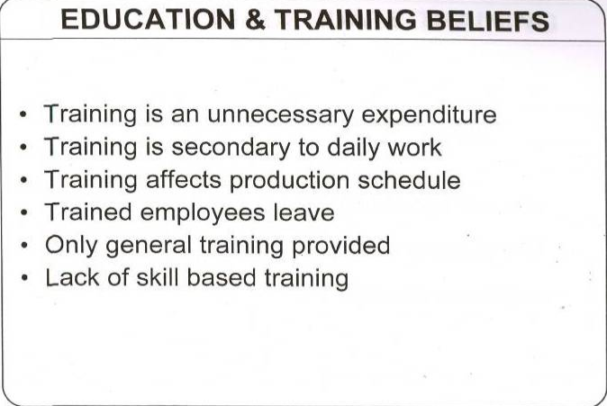

Slide 8
4 Insufficient Training result into

Slide 9
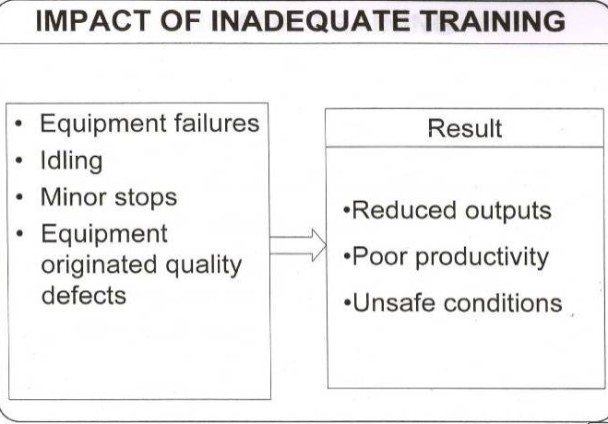

Slide 10
5 Why Training needed?

Slide 11
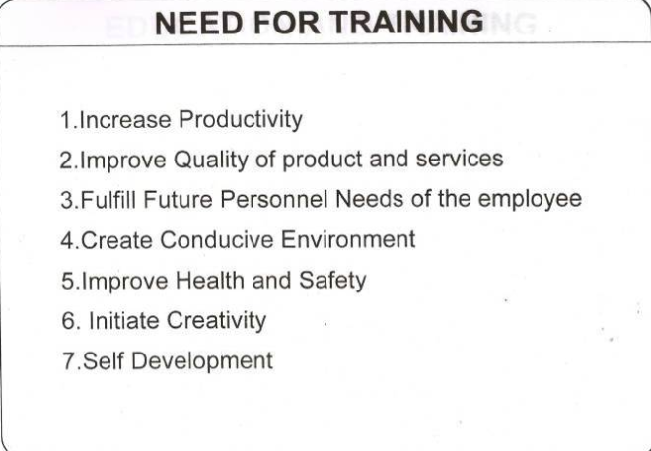

Slide 12
6 Why E & T Most Important ?

Slide 13
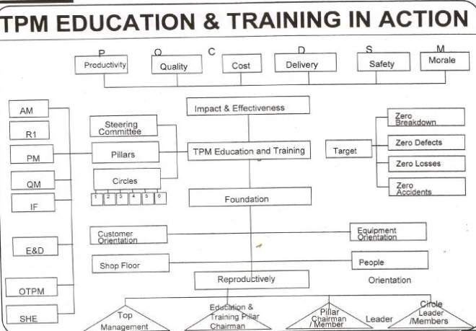

Slide 14
6.1Basic Philosophy of Education & Training
Class ROOM Training
On the Job (OJT) Training
Self Development
Improve the ability of Individuals
Improving company’s Bottom Line
JH Aims
Equipment competent operator JH Step-4
Process competent operator JH Step-5

Slide 15
6.2 Who is Equipment Competent Operator
Detect & Attend Abnormalities
Knowledge of equipment structure & functions
Knowledge of relationship between equipment & quality
Can understand & repair equipment

Slide 16
7.HOW TO PLAN FOR TRAINING

Slide 17
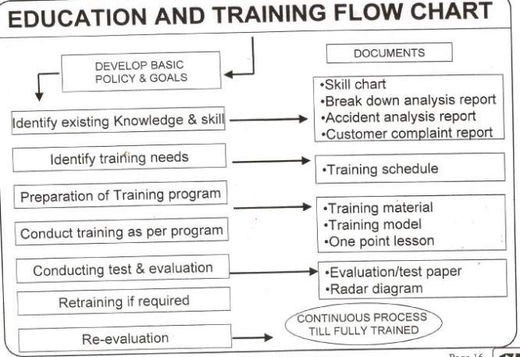

Slide 18
7.1 E & T AIM

Slide 19
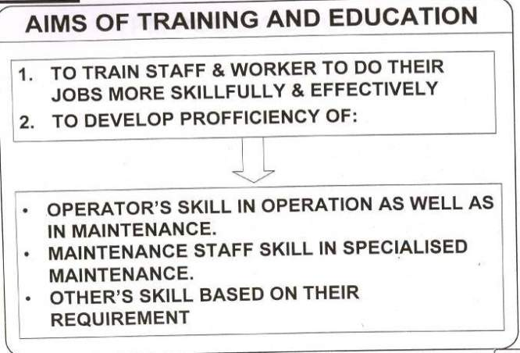

Slide 20
7.2 Initial Evaluation sheet Sample

Slide 21
7.2 Initial Evaluation sheet Sample
Work / classification` | Knowledge / skill item | Ajay | Sharad | Shyam | Sachin | Ramesh | Salman
Basics | Use & knowledge of Tools
 | Nuts & Bolts
Work Skill | Use & knowledge of Drawings
 | Lubricant
Others | Knowledge of Process
Do not know the subject
Know the subject but can not do the job
Can do as well as can teach
Know the subject and can do the job

Slide 22
7.3 TRAINING CALENDER EXAMPLE

Slide 23
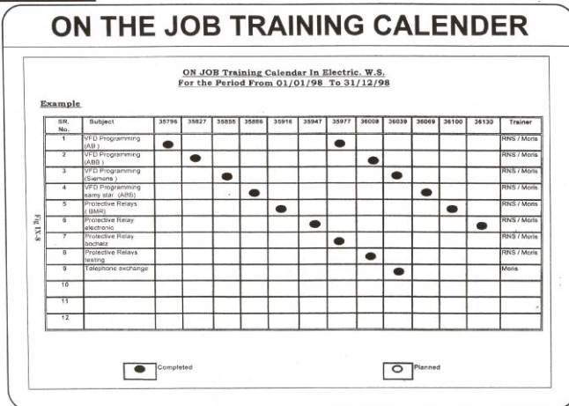

Slide 24
7.4 PREPARATION OF TRAINING
MATERIAL

Slide 25






E & T
7.4 Preparation of training Material
Training given to operator about squeezing operation.
Identification
stamp on foam
Foam takeout
From mould with
Both hand.
Put foam on
Squeezer belt.
Squeeze the foam
Through roller.

Slide 26
7.5 TEAM FORMATION
INHOUSE EXPERT
FOR TRAINING
ON TOPIC

Slide 27
A Team Of Inhouse Experts Was Formed for training
Lubrication.
Hydraulics.
Fasteners
Training
Topics
Pneumatics
Drives
Electrical
Enviornment
Safety
44

Slide 28
7.6 TRAINING ARRANGEMENT

Slide 29
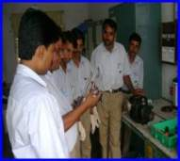
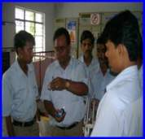
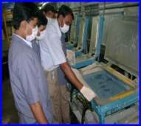
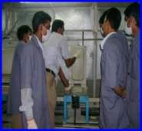
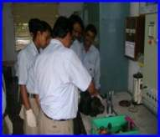
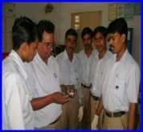
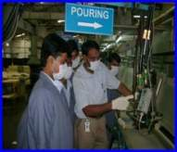
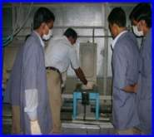
Training
Class Room Training.
On Job Training.
Speech on feeding pump by
Mr.D.B.Sharma
Speech on R.M. Filter by
Mr.D.B.Sharma
Speech on insert fitment by
Mr S.U..Hugewar
Speech on mould cleaning
by Mr S.U.Hugewar
Speech on R.M.Pump by
Mr.D.B.Sharma
Speech on sleeve by
Mr.D.B.Sharma
Speech on operating panel
by Mr.S.U.Hugewar
Speech on application of
Rel. agent by Mr.S.U.Hugewar

Slide 30
7.7 TRAINING THROUGH ONE
POINT LESSION

Slide 31
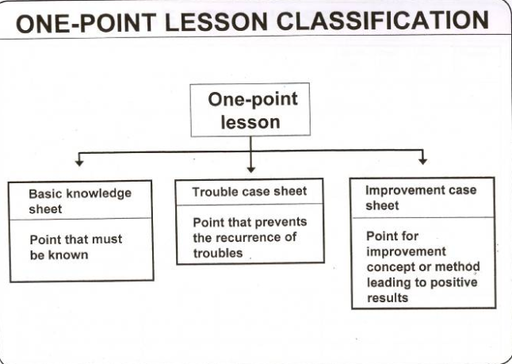

Slide 32
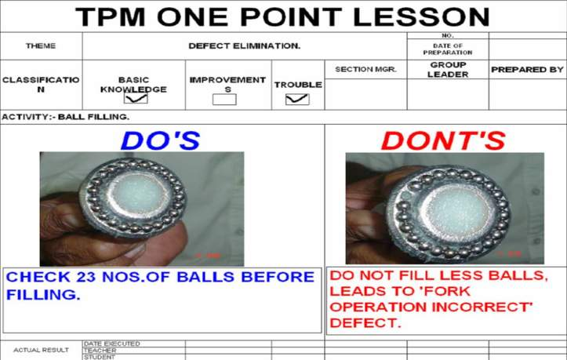

Slide 33
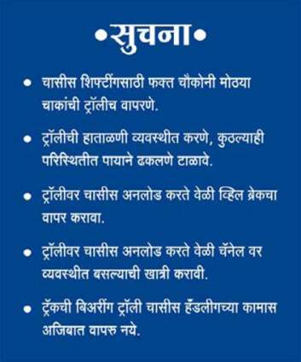
PREPARE AND DISPLAY OPL : INJURY
Example :-
One point lesson for Safe
Handling of Trolley.
One point lesson displayed
At work stages.
Training input to Workmen
Horizontal deployment.

Slide 34
8.0 DEFINITION OF KNOWLEDGE

Slide 35
Knowledge
Knowledge refers to the state or condition of understanding that fact or subject.
Knowledge alone will not give result.
Knowledge can be recognized with skill.
Education is the base to get knowledge.

Slide 36
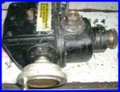
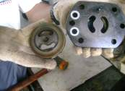
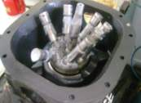
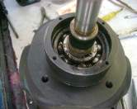
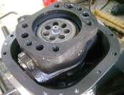
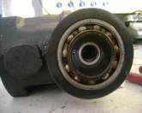
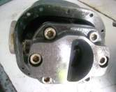
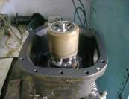
Details Of Knowledge about Parts Of Machines.
1
4
7
R.M.Pump.
Pump Inlet & outlet plate.
Axial piston.
2
5
8
Bearing Housing
Flow control bracket.
Bearing
3
6
Suction assembly.
Piston housing.

Slide 37
9.0 DEFINITION OF SKILL

Slide 38
Skill
Skill is the ability to act reflexively and learn on all phenomenon to sustain it for long time
Mastery is the end result
Knowledge and skill are inter related term.

Slide 39
9.1 SKILL AVAILABILITY
&
JOB REQUIREMENT

Slide 40
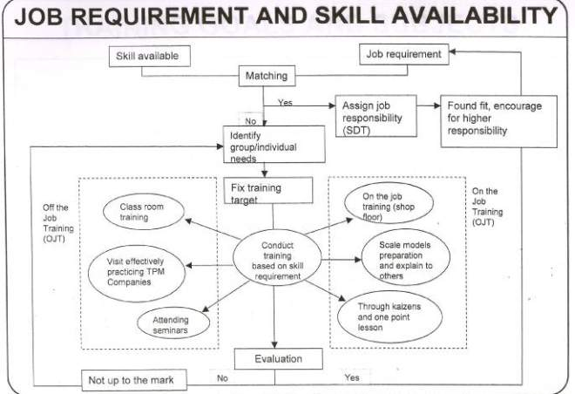

Slide 41
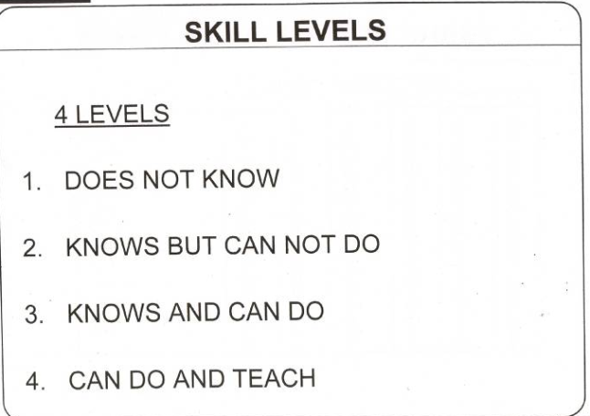

Slide 42
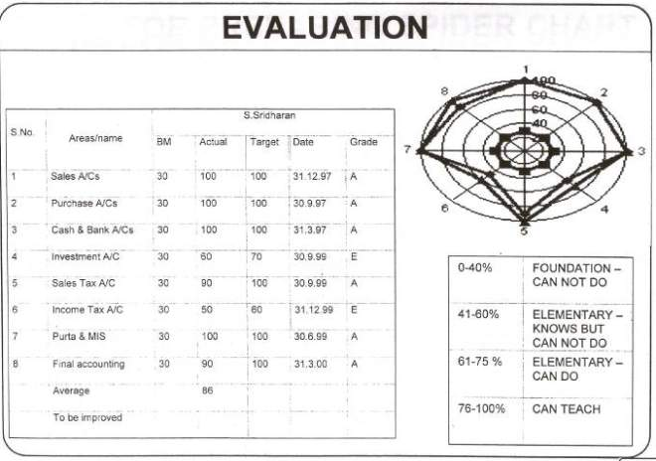

Slide 43
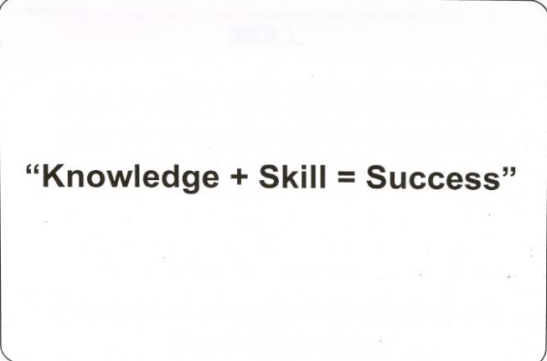

Slide 44
6.2 EXAMPLE OF SUCCESS

Slide 45
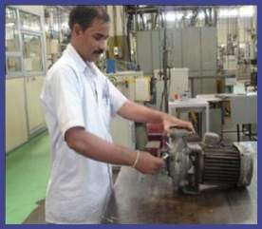
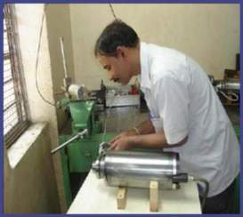
Skill Enhancement of Maintenance Workmen
Example – After Imparting Training – Skill level Growth status
Training Imparted
Bearing & Lubrication
Spindle Assembly &
Disassembly
Reading drawings
Of Assembly &
Hydraulic circuits
Servicing of
Hydraulics pumps
Inspection &
Measurement of
CBM parts
BEFORE
Working on Centrifugal
pump
AFTER
Working on High speed
Precision Grinding spindle

Slide 46
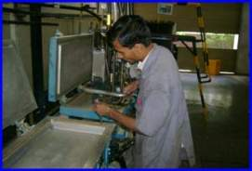
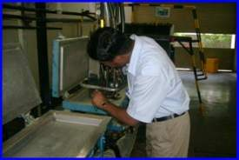
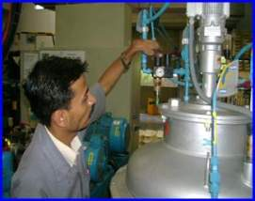
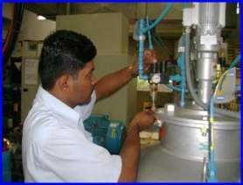
Effectiveness Of JH Upgraded Skill
Minor Fault Set By Maintenance Operator
Minor Fault Set By Production Operator
Injector & Nozzle Cleaning.
Injector & Nozzle Cleaning.
Air Pressure Regulator Setting.
Air Pressure Regulator Setting.

Slide 47
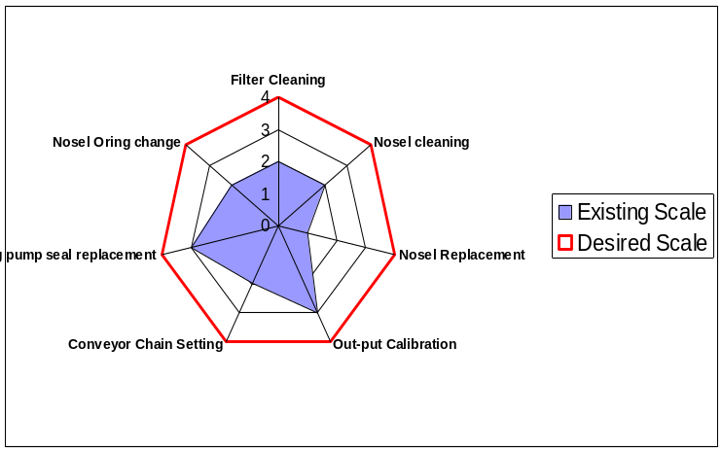
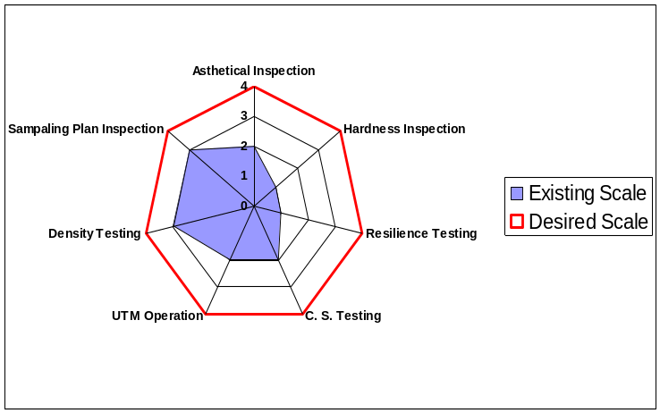
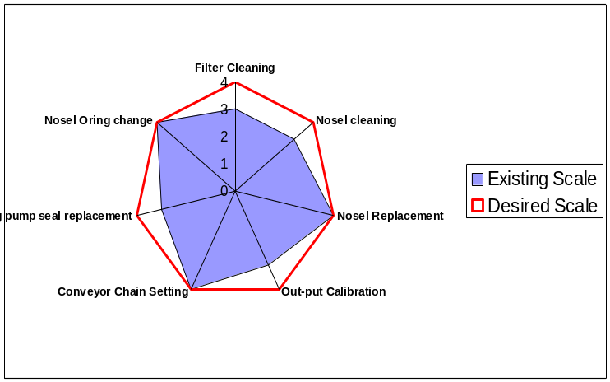
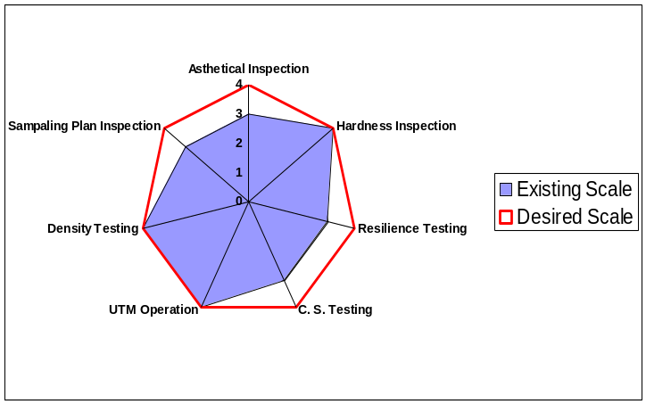
Skill Level of Operator – After Training
Mr. S.D. Mate - 6068
Mr. M.S. Dahe - 1837

Slide 48
THANK YOU

Slide 49
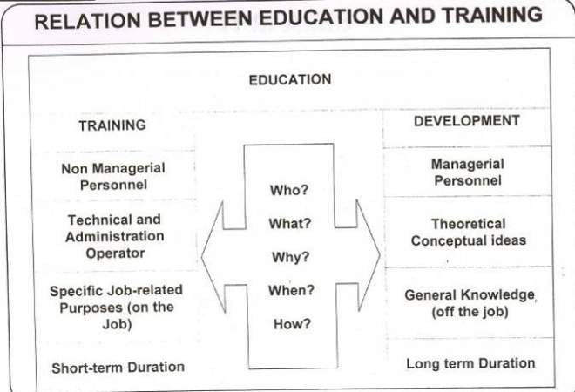

Slide 50
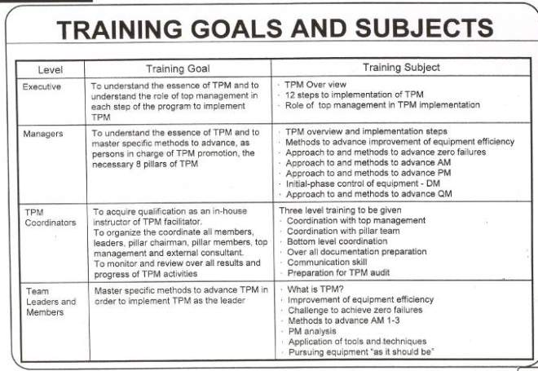

Slide 51
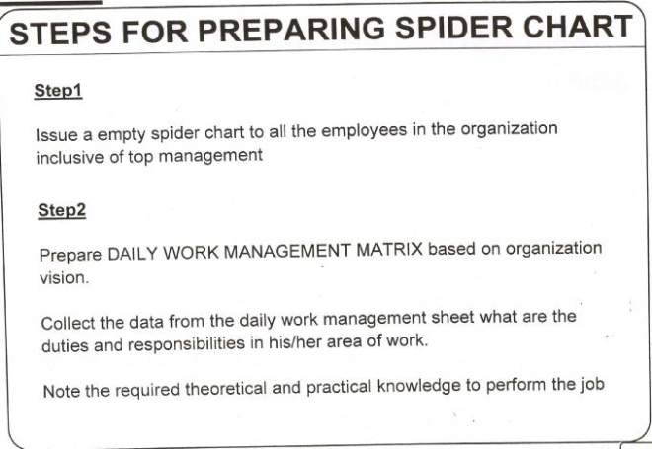

Slide 52
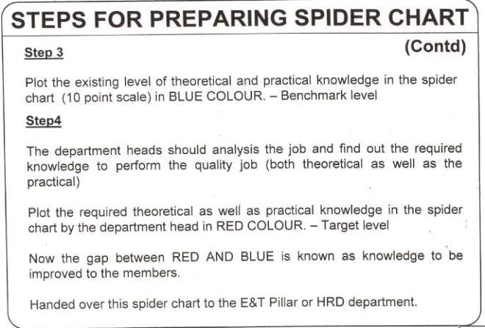

Slide 53
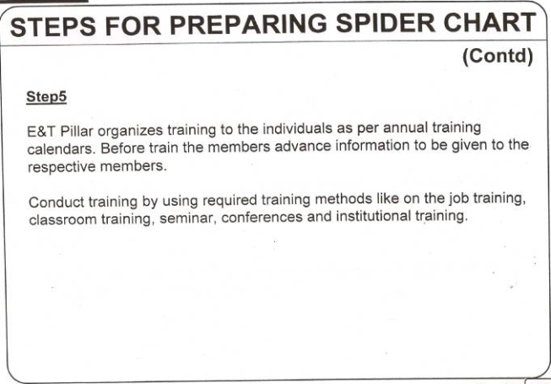

Slide 54
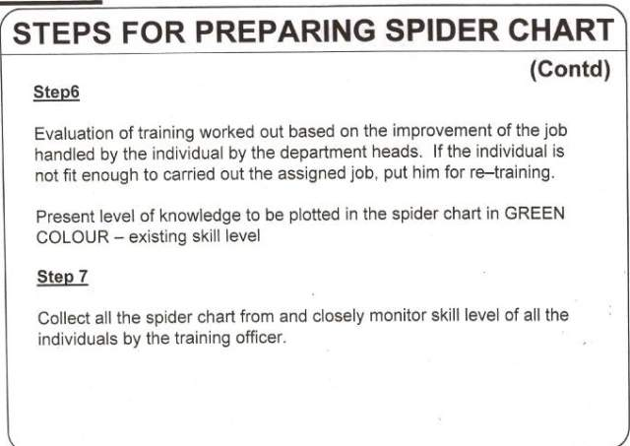

Slide 55
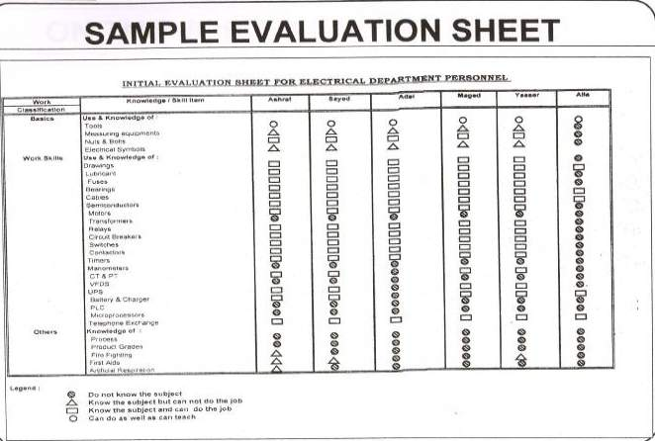

Slide 56
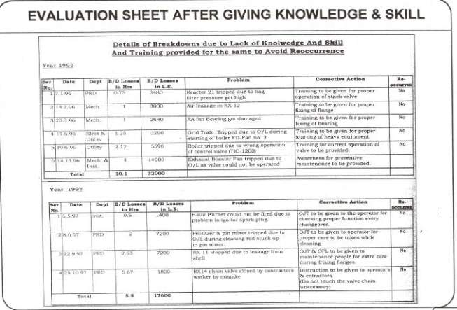

Slide 57
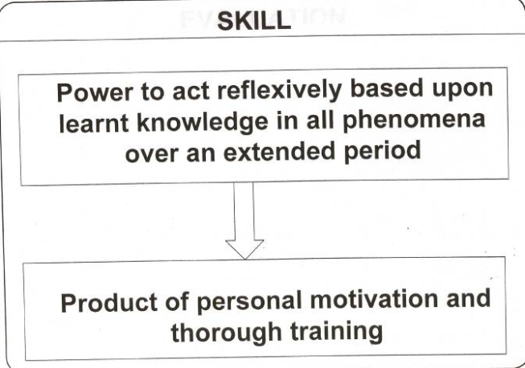

Slide 58

9.5.4 Other Training Program

Slide 59
EXAMPLE E & T AIM

Slide 60


Slide 61
E & T TPM POLICY

Slide 62


Slide 63


Slide 64


Slide 65


Slide 66


Slide 67


Slide 68
E & T
Methodology
Analysis of training needs through skill matrix
Training compilation
Annual Training program
Re-training
Training Evaluation & Effectiveness
Co- ordination for training
Not Ok
Update the skill level
Ok

